Slide 1
District Urban Area Boundary and Functional Classification Process Webinar
June 21st, 2023

Slide 2





Introductions
Transportation Data Inventory
Joel Worrell
Section Manager/
Contract Manager
(850) 414-4715
Joel.Worrell@dot.state.fl.us
Jerry Scott
Multimodal Data
System Coordinator
(850) 414-4714
Jerry.Scott@dot.state.fl.us
Makarand Gawade
Transportation
Project Planner
Makarand.Gawade@hdrinc.com
Brittany Wood
Transportation
Data Specialist
Brittany.Wood@hdrinc.com

Slide 3
Overview
Background
Update on Procedure and Handbook
Urban Area Boundary (UAB) Adjustment Guidelines and Considerations
Functional Classification (FC) Guidelines and Considerations
UAB-FC Do’s and Don’ts
Questions
Notes:
During today's presentation, we will offer a brief overview of urban area boundaries and functional classification, followed by an explanation of the update process. Subsequently, we will delve into the UAB and FC guidelines in more detail in the next two sections. We will touch upon important considerations and provide some examples of what to do and what to avoid. Finally, we will reserve some time for any questions you may have.

Slide 4
Background

Slide 5

Defining Urban Area Boundaries
Finalized Urban Areas Released December 2022
Urban Areas are revised every 10 years based on population counts from decennial census.
FHWA Urban Area Boundaries are adjusted to be consistent with transportation needs.
Functional classification reviewed and updated in conjunction with adjusted urban boundaries.
Notes:
The U.S. Census revises urban areas every 10 years based on the population counts from the most recent decennial census. This has been occurring since 1790. You can see the growth of US population over 220 years on the slide. The 2020 numbers are starting to come in – Census recently released the apportionment results which impacted the number of seats in the House.
State DOTs have the option of adjusting or ‘smoothing’ the census-defined boundaries to be more consistent with transportation needs. Lot of people don’t realize that the urban boundaries are different from urban areas – urban areas are established by the Census, urban boundaries are approved by FHWA and used for transportation planning purposes. States also revise the functional classification of the state highway system in conjunction with the urban boundary update.

Slide 6
Defining Functional Classification
Integrated review of Urban Area Boundaries and Functional Classification of their road system.
Functional classification defines how roadway segments function through the roadway network.
Functional Classification | Florida Mileage | Florida VMT
Principal Arterial-Interstate | 1,495 | 114,421,262
Principal Arterial-Freeways & Expressways | 776 | 46,702,477
Principal Arterial-Other | 6,572 | 146,887,000
Minor Arterial | 6,424 | 89,136,097
Major Collector | 10,492 | 64,562,113
Minor Collector | 5,084 | 14,749,883
Local | 92,809 | 119,613,433
Total | 123,652 | 596,072,265
Source: Public Road Mileage and Miles Traveled, 2021
Notes:
As mentioned briefly on a previous slide, FHWA advises states to also reassess their functional classification designations. This is because functional classifications play a crucial role in segment classification.

Slide 7
Process Benefits and Impacts
Project Funding
Supports the determination of Federal-Aid Eligibility for roadways, bridge, and transit funding:
Programs and Partners
Data Analysis
Functional Classification.
Surface Transportation Block Grant Program (STBG) Apportionments.
Federal Transportation System Designations (NHS, STRAHNET).
Updates to all Enterprise RCI/LRS Data and GIS Mapping Products.
Traffic Analysis Zones.
Vehicle Miles Traveled Estimates.
Local Agency Programs (LAP).
Congressional Districts.
Federal Transit Administration (FTA) Apportionments.
Supports the identification of Transportation Management Areas (TMAs).
TIP and STIP updates.
Highway Design Standards.
Context Classifications.
MPO Creation and Boundary Adjustments.
Urban/Rural Classifications.
Notes:
So why is this important? It impacts a whole bunch of things as you can see on the slide. I’ll point out a few. Funding is a critical piece – most formula funds are distributed based on population. MPO boundaries may also change, sometimes MPOs get consolidated/ redefined, it also impacts composition of MPO boards. So this can get really contentious and political.

Slide 8

Process Timeline
Dec. 2022/Jan. 2023
Summer 2023
November 2023
December 2024
April 2025
U.S. Census Bureau/FHWA release final Urban Areas
FHWA publishes list of designated TMAs
MPOs submit apportionment plan and MPO boundary maps
FDOT updates business systems with final smoothed/adjusted Urban Area Boundaries and approved Functional Classification
FDOT submission of final statewide Urban Area Boundaries and Functional Classification data to FHWA
May 2023
Before Oct. 1, 2023
May 2024
Fall 2024 - 2026
FDOT provides official notification to the Districts and MPOs to begin adjusting Urban Area Boundaries
FDOT/MPOAC submits Metropolitan Planning Funds (PL) allocation formula to FHWA
FDOT and FHWA finalize the smoothed/adjusted Urban Area Boundaries
MPOs adopt 2050 LRTPs
Notes:
U.S Census Bureau released the final urban areas in January 2023. Since then, we have been discussing the process timeline within Central Office and this is the most uptodate timeline. As you can see here, it identifies the major milestones. It is advised for different districts that they develop their intermediate

Slide 9
Roles and Responsibilities
Federal Highway Administration (FHWA)
Provides Urban Area boundaries (UABs) and Functional Classification designation guidance.
FDOT Central Office
Provides finalized 2020 UABs from US Census Bureau to Districts.
Districts
Receives UAB and Functional Classification data from FDOT’s TDA Office.
Metropolitan/Transportation Planning Organizations (MPOs/TPOs)
Updates its Metropolitan Planning Area (MPA) boundary maps in consultation with the District, which is also known as the MPO Boundary Map.
Updates its Apportionment Plan, which is the MPO’s voting membership structure.
Coordinates with local governments and the District on the process to adjust the functional classification of roadways within the MPO area.
Coordinates reviews with local agency partners and regional workshops with MPOs.
Coordinates proposed changes from planning partners and acquires signatures from local agencies.
Performs functional classifications reviews with local entities.
Delivers proposed changes of UAB maps, data, and functional classification applications for FDOT TDA Office review and FHWA submission.
Develops procedures, handbooks, guidance, and training on the UAB adjustment and functional classification update process for Districts.
Coordinates CO review and approval of UAB maps and functional classification applications with FHWA.
Updates FDOT enterprise systems and submits official data to the FHWA Highway Performance Monitoring System (HPMS).
Reviews and approves final adjusted UABs and Functional Classification designations applications made by FDOT and local entities.
Notes:
In the state of Florida, the Urban Area Boundary and functional classification designation process is conducted in coordination with FHWA, FDOT, and local partners. The FDOT takes the lead role to coordinate the process in collaboration with the Metropolitan Planning Organizations (MPOs), counties, and local municipalities.

Slide 10
Update on Procedure and Handbook

Slide 11
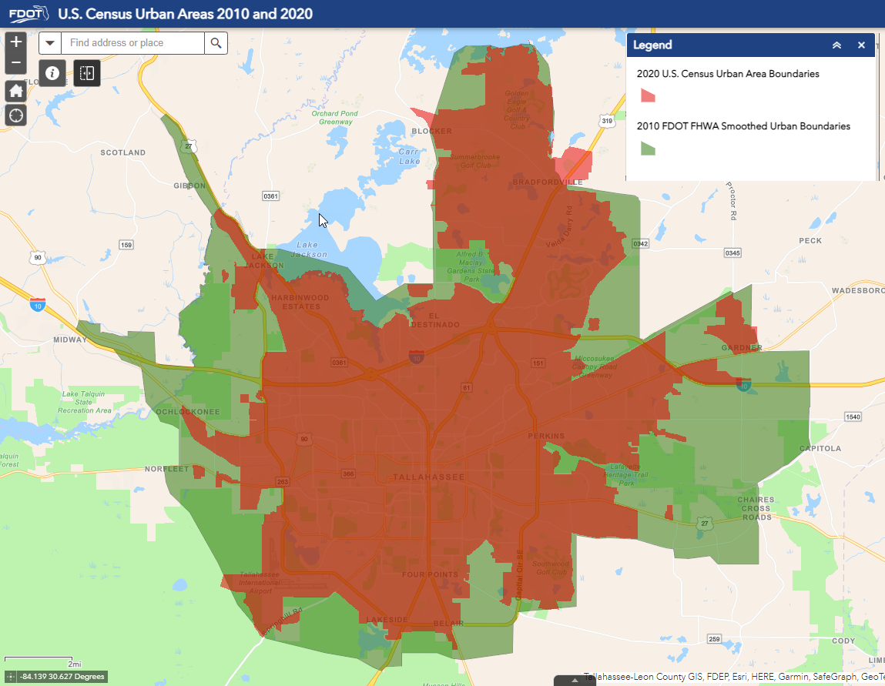
Procedure Update (525-020-311)
Published May 2023
Updated responsible office for Urban Area Review, e.g., TDA Office.
Included new U.S. Census Bureau criteria/definitions.
Updated FHWA programming preferences to designation criteria.
Added process to obtain Governor’s delegation for FDOT Secretary (or delegate) signature to sign and approve all maps adjustments.
Clarified Urban Area adjustment process and Functional Classification Review process steps: Added interim update guidance for modifications of Functional Classification updates between decennial census cycles. Added standardization of map package requirements.

Slide 12
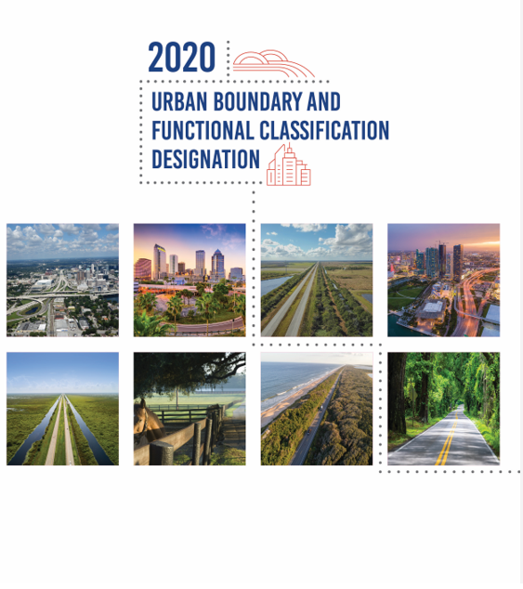
Handbook Update
Ready early-July (to include):
Included new U.S. Census Bureau criteria/definitions.
Best practices.
GIS Formatting examples.
Flow Charts – Urban Area Boundary and Functional Classification.
Map Templates/Requirements.

Slide 13
Urban Area Boundary and Functional Classification Update Process
Notes:
Let us delve now into UAB guidelines and considerations.
Area Boundary Adjustment Considerations, refers to things that people should consider when adjusting the boundary.
They're kind of like guidelines, they're not really requirements.
The following slides describes these considerations with examples.

Slide 14
FHWA Urban Area Boundary Adjustment Recommendations
Recommended 12-month schedule following Census release of Urban Area Boundaries.
At a minimum – confirm Census boundaries are adequate.
Build/share understanding of game plan.
Generate maps and share electronically – use GIS.
Encourage/work towards timely delivery of revisions.
Event | Months Following Release of 2020 Census Urban Area boundaries
FHWA issues transmittal letter. | Month 1
Begin adjusted urban area boundary update process. | Month 1
DOT works with planning partners to define adjusted urban area boundaries. | Month 3-9
Provide draft final data and/or maps to FHWA Division Office for review. | Month 10
DOT incorporates Review Comments. | Month 11
DOT submits adjusted urban area boundaries to FHWA Office of Planning. | Month 12
Notes:
Talk points as they are.

Slide 15
Urban Area Boundary Process Flow Chart
TDA
Develop draft new UB, with MPOs and/or local government staff
Get signature of MPO and/or local government official
Distribute map copies
PROCESS COMPLETE
The District
No
Yes
FHWA Requests New UAB (every 10 years) from FDOT
TDA updates Procedures, Handbooks, & Training
Obtain Census boundary files from FHWA
Provide files to Districts with new Census boundaries in GIS format
Draft boundary reviewed by TDA & FHWA
Is the Boundary consistent with requirements?
Acquire FDOT Secretary and FHWA signatures
Update RCI Feature 124

Slide 16
FHWA Functional Classification Review Recommendations
Create a multi-agency review team - stay in touch.
Build and share understanding of game plan.
Generate maps and share electronically – use GIS.
Encourage/work towards timely delivery of Functional Classification revisions.
Event | Month Following FHWA Adjusted Urban Area Boundary Approval
State DOT launches the formal Functional Classification update process after FHWA approves the State’s adjusted urban area boundaries. | Month 1
State DOT works with planning partners to review and propose changes to the functional classification of its roadways. | Months 2-17
State DOT gathers and processes all proposed function classification changes and submit draft final data and/or maps to FHWA division office for review. | Months 18-20
DOT incorporates updates into planning process and related databases, to ensure submittal of updated functional classification in upcoming June 15th HPMS submittal. | Months 22-24
Notes:
Talk points as they are.

Slide 17
Functional Classification Process Flow Chart
TDA
The District
Meet with MPOs and/or local governments
Define FC with MPO and/or local government staff
Coordinate with other counties, Districts, and states at boundaries
Prepare draft maps & spreadsheet
Get signature of MPO and/or local government official and the District
PROCESS COMPLETE
No
Yes
FHWA Requests review of FC* (every 10 years)
TDA updates Procedures, Handbooks, & Training
Provide maps to Districts with new Census boundaries in GIS format
Draft FC review by TDA & FHWA
FC consistent with requirement?
Acquire FHWA signature on final maps
Distribute maps & spreadsheet
Update RCI Feature 121 PROFUNCL
FC* = Functional Classification

Slide 18
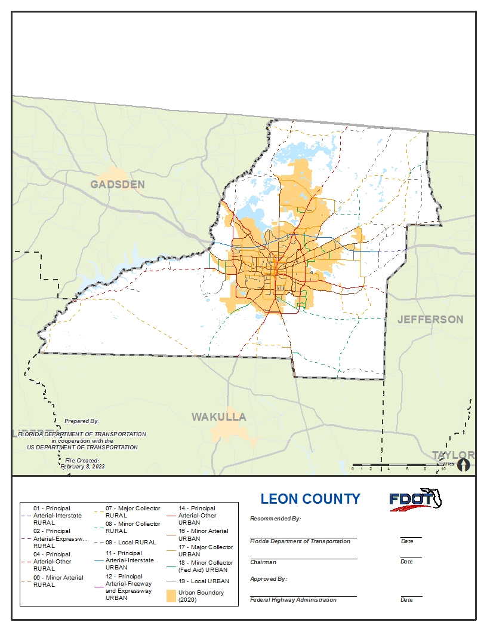

UABFC Map Requirements
Adhere to line symbology required by FDOT.
Coordinate projection system: EPSG:26917: NAD83/UTM zone 17N.
Legend detailing urban boundary and functional classification symbology.
‘Recommended by:’ Signature/Date blocks for FDOT and the Local Entity.
‘Approved by:’ Signature/Date block for FHWA.
Include colored FDOT logo.
File created date.
Prepared by and in cooperation with statement.
County title.
Include a compass rose.
Include map scale in miles.
Provide separate inset maps of main urban areas within the county.
Notes:
Ensuring standardization in our maps is of utmost importance. The following list of requirements outlines the specific criteria we need to adhere to. County Map templates and Functional Classification layer symbology are provided to facilitate mapping of the proposed Urban Boundary Adjustments and Functional Classification Updates. Districts may use their own map styles as long as all elements listed above are included in the final maps. We will be sending these templates as part of handbook updates to districts.

Slide 19
UAB GIS Data Format
Field Name | Data Type | Length | Description
YEARRECORD | Small Integer | 4 | Year for which the data apply (2020)
URBANCODE | Small Integer | 5 | Census Urban Code
URBANNAME | String | 100 | Urban Name
CENSUSPOP | Double | 8 | Census Population
CENSUSHH | Double | 8 | Census Housing Units
CENSUSLANDAREA | Double | 8 | Census Land Area (in square miles)
ADJUSTEDUABLANDAREA | Double | 8 | Adjusted Urban Area Boundary Area (in square miles)
SHAPE | Polygon | NA | Polygon Feature
Provide an adjusted urban area boundary dataset to TDA within an ESRI Geodatabase/Feature Class format.
Provide data with the EPSG:26917: NAD83/UTM zone 17N coordinate projection system.
Notes:
This slides outlines the data formats and required attributes for UAB submissions.

Slide 20
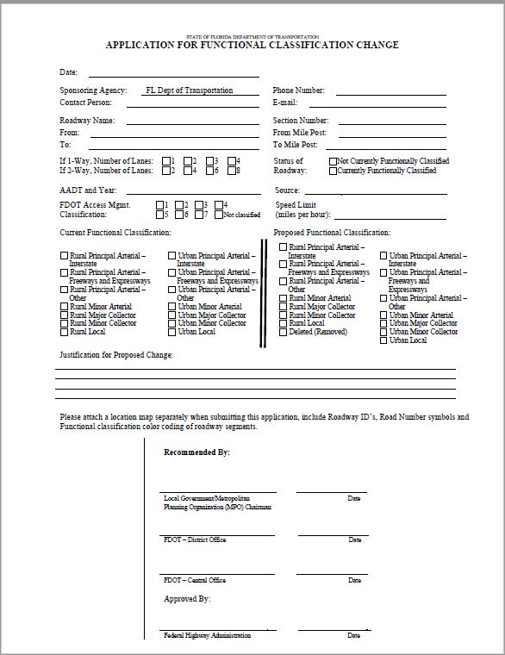
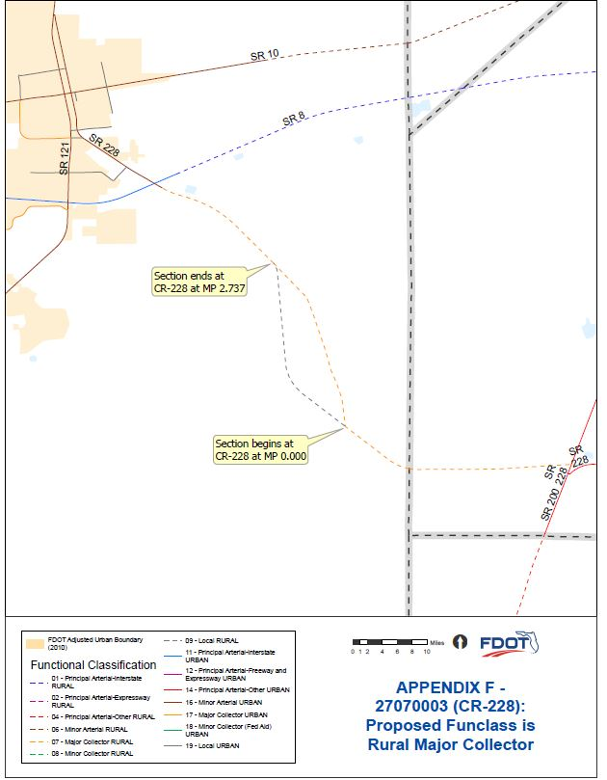
Functional Classification Reviews
GIS geodatabase format required to perform an expedited review.
District submissions of Functional Classification must include the following supporting data elements:
  Roadway ID
  Begin MP
  End MP
  AADT
  Number of Lanes
  Refer to form for required attributes.
TDA will finalize these elements at a later date.
Notes:
Districts have consistently followed a standardized process when submitting functional classification change applications. We will continue to adhere to this process for the current major effort. In order to streamline the process, we will collaborate with districts to determine the feasibility of receiving batch loads of changes simultaneously. It is strongly advised that you submit these changes well in advance to mitigate any potential concerns as the deadlines approach.
Now, I would like to pause and open the floor for 2-3 questions. Please keep in mind that we have a lot of material to cover.

Slide 21
Urban Area Boundary Adjustment Guidelines and Considerations

Slide 22
Recommended Statewide Datasets
Suggested GIS Layer | Name of Dataset | Recommended Official Statewide Data Source
Land use, including areas of recent growth | Parcel Data | Florida Department of Revenue
 | Generalized Future Land Use | Florida Geographic Data Library
 | Land Use/Land Cover | Florida Department of Environmental Protection/ Water Management Districts
Roadway network | RCI LRS | Florida Department of Transportation
Railroads | FDOT Rail LRS | Florida Department of Transportation
Transit routes | Florida Transit Information System | Florida Transit Data Exchange
Ports (airports, seaports) | SIS Facilities | Florida Department of Transportation
 | Airports | Bureau of Transportation Statistics
 | Airport Parcels | Florida Department of Revenue
Military installations | Military Parcels | Florida Department of Revenue
Other significant traffic generators | Freight Facilities (Commercial, Residential, Industrial) | Florida Department of Transportation
Hydrography | National Hydrographic Dataset - Flowlines | Florida Department of Environmental Protection/ Water Management Districts
 | National Hydrographic Dataset - Waterbodies | Florida Department of Environmental Protection/ Water Management Districts
 | FDOT Aerials | Florida Department of Transportation
Municipal boundaries | Cities | Florida Geographic Data Library
Digital ortho-photography | FDOT Aerials | Florida Department of Transportation
Notes:
The first step in determining how to adjust Census Urban Areas is to obtain the applicable supporting data and documentation which includes but is not limited to the datasets listed here. We have listed suggestions and the recommended statewide data sources here.
2020 U.S. Census urban area data
Land use showing areas of recent growth
Roadway Networks
Transit Routes
Ports
Military Installations
Other significant traffic generators
Hydrography
Municipal boundaries
Latest aerial imagery

Slide 23
Urban Area Adjustment Considerations
Include entire municipality.
Include areas with Urban Characteristics.
Include large/significant traffic generators.
Boundary should follow municipal limits or physical features.
Boundary should be simple without irregularities.
Boundary should not split roadways or ramps.
The only official requirement is that an adjusted boundary includes the original urban area delineated by the Census Bureau in its entirety.
Notes:
Here listed are the considerations we will be reviewing. Please remember that these are CONSIDERATIONS and NOT requirements. The only official requirement is that an adjusted boundary includes the original urban area delineated by the Census Bureau in its entirety.

Slide 24
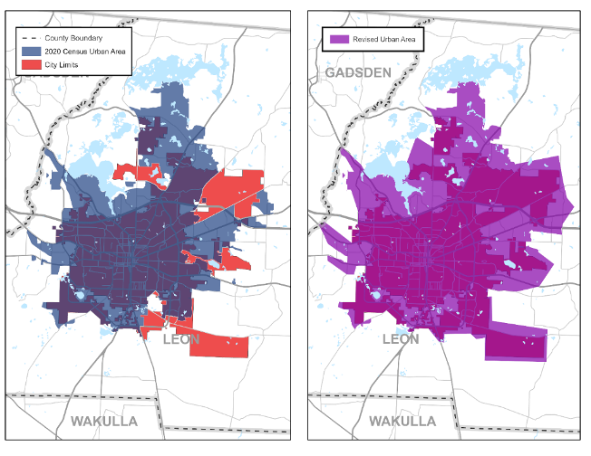
Include entire Municipality
Notes:
The adjusted urban area should consider official municipal boundaries and an effort can be made to ensure that the urban area is adjusted to fully encapsulate municipalities.
In the example on the left, the reds are the city limits of the City of Tallahassee and the blues are the urban area.
On the right is an example of how it could be revised to include all the city limits, or municipalities.

Slide 25
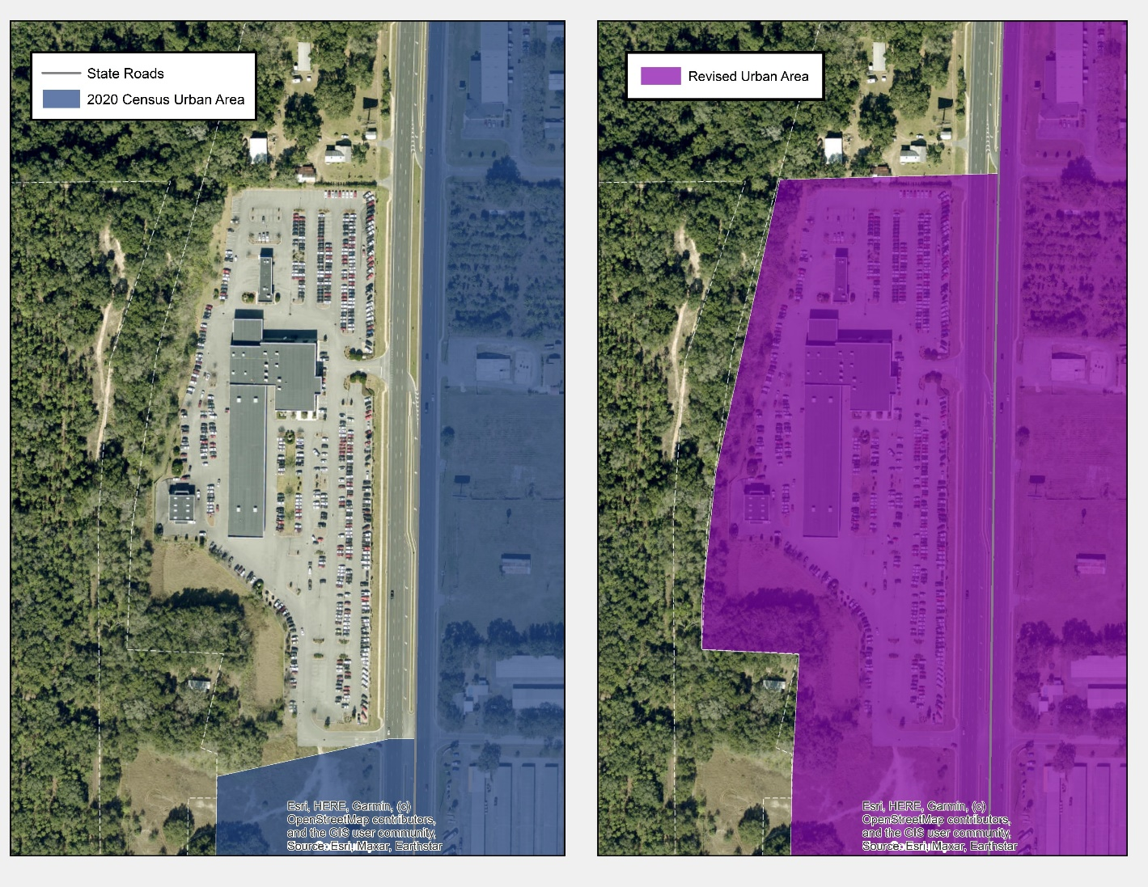
Include areas with Urban Characteristics
Notes:
The adjusted urban area should be adjusted to include any areas with urban characteristics such as large shopping centers, residential neighborhoods, or any other developed areas.
In the example on the left, this shows a shopping center being left out of the Urban Area.
On the right it has been revised to include the shopping center.

Slide 26
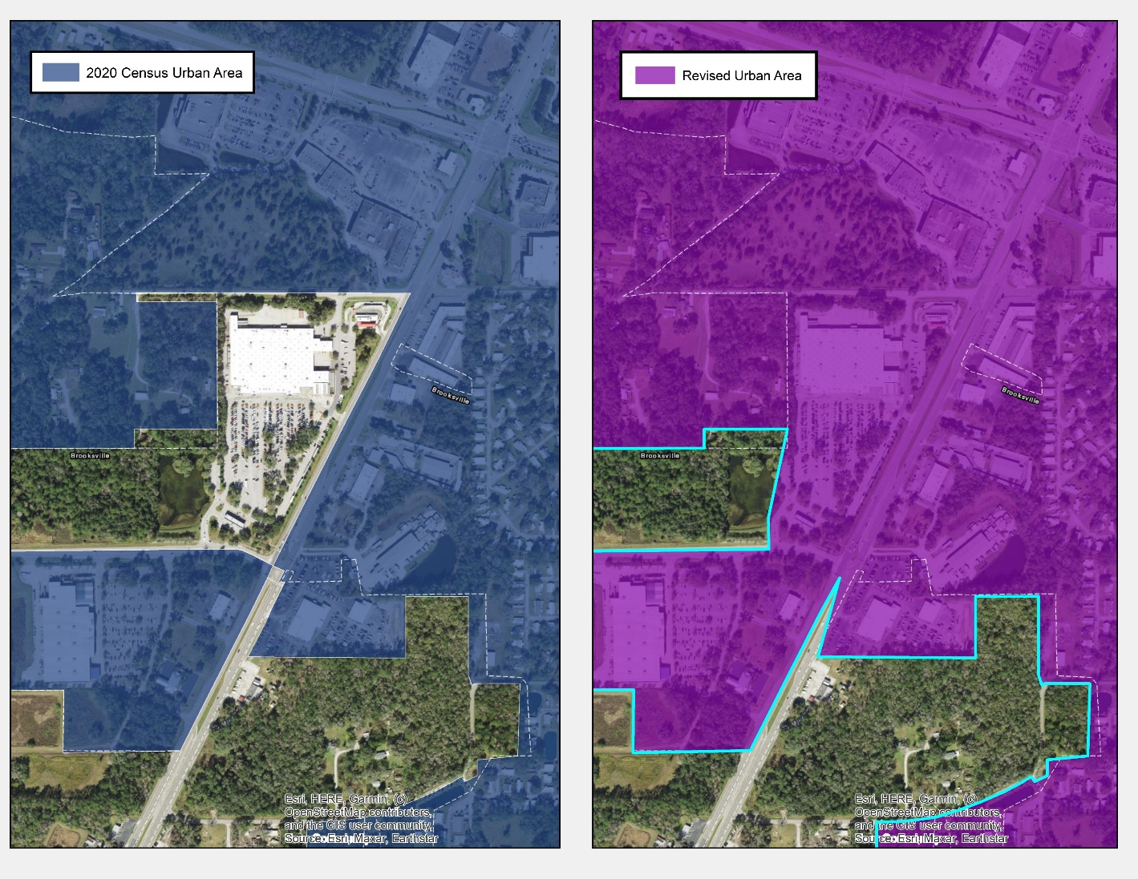
Include large/significant traffic generators
Notes:
The adjusted urban area boundary should be adjusted to include all large traffic generators that are within a reasonable distance from the urban area (e.g., fringe area public parks, large places of assembly, large industrial plants, etc.)
Here is another example of a large shopping center or Walmart which is a large traffic generator.
On the right the boundary has been adjusted to include the Walmart.

Slide 27
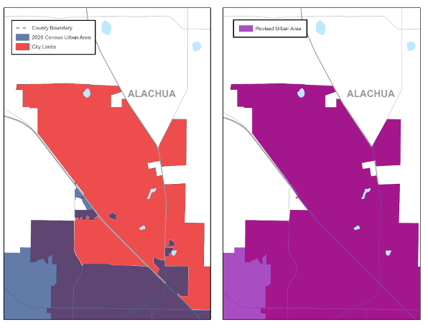
Boundary should follow municipal limits or physical features
Notes:
The adjusted urban area boundary should be defined so that its physical location is easy to discern from data shown on the map. Whenever possible, the boundary should follow political jurisdictional boundaries or physical features (e.g., rivers, streams, transmission lines, railroads, streets or highways).
On the left the Urban Area leaves out the municipal limits of the City of Gainesville and on the right it has been adjusted to include the city limits and the new adjusted boundary follows the municipal boundary limits.

Slide 28
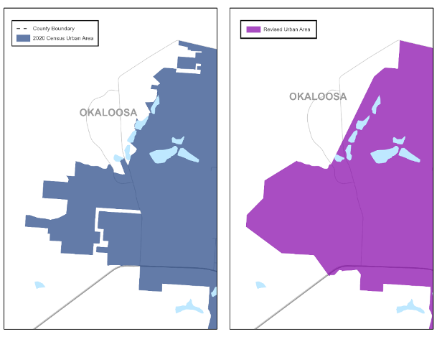
Boundary should be simple without irregularities
Notes:
After the adjusted urban area boundary has been defined using all the other factors, remaining boundary irregularities should be minimized to avoid confusion that irregular boundaries can create.
The example on the left shows the Urban Area associated with Crestview and it shows various jagged lines.
The example on the right shows the adjusted boundary where certain boundaries have been smoothed so they are simple with no jagged edges and without irregularities.

Slide 29
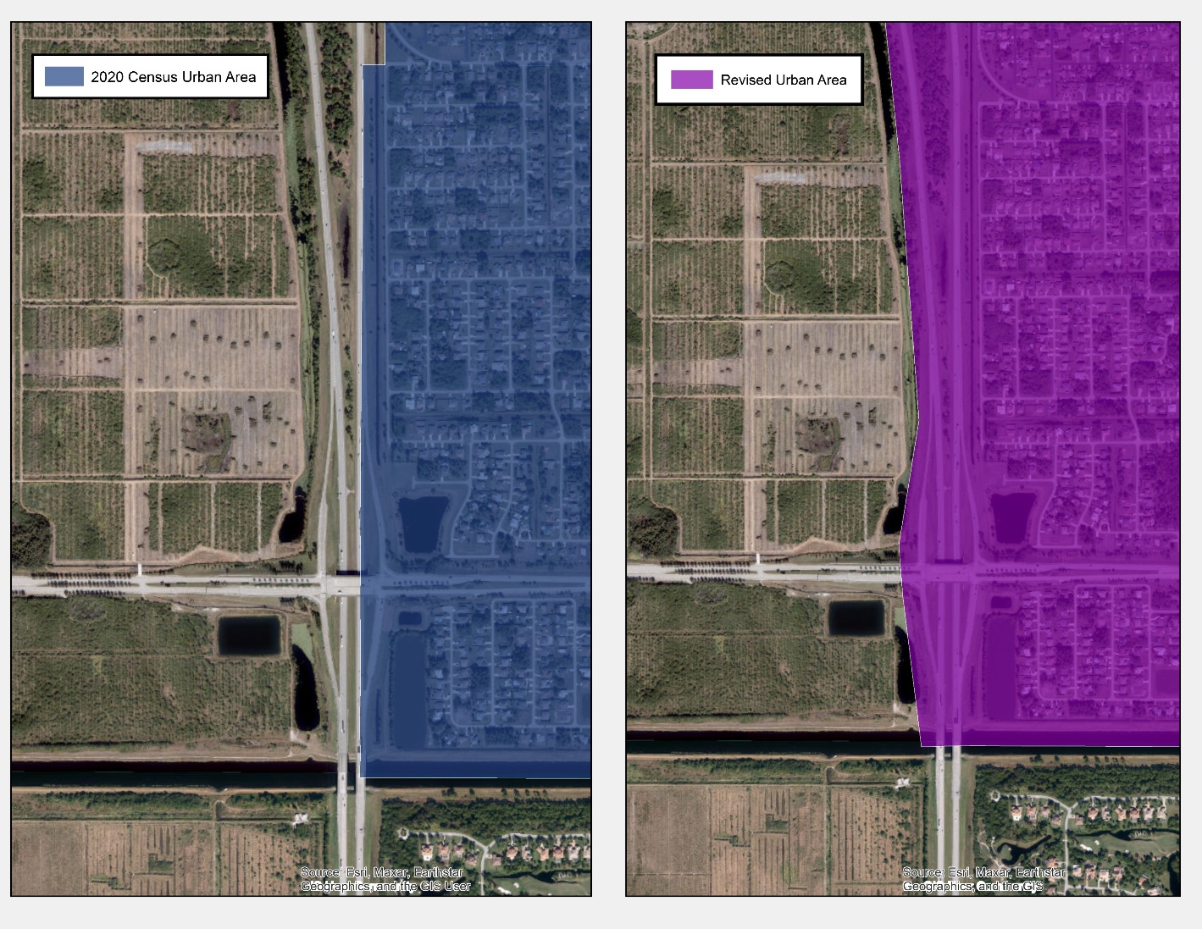
Boundary should not split roadways or ramps
Notes:
Boundaries should not be drawn in the middle of a divided highway or ramp. The divided highway or ramp should be either completely within or out of the urban area boundary.
The example on the left shows a boundary with a ramp inside of it.
On the right it is extended to include the both ramps and both of the roadway features all the way up.
And the boundary should be one contiguous area. The left shows a bunch of little pieces. The right shows everything contained within one solid boundary.

Slide 30
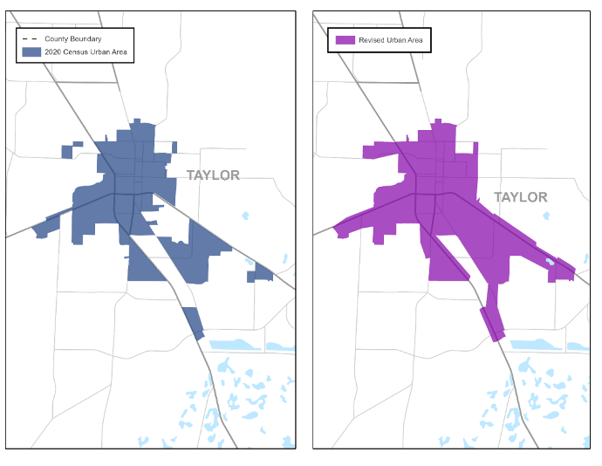
Boundary should be contiguous
Notes:
The adjusted urban area boundary can be adjusted so that it is one, single contiguous area.
The example on the left shows a Census area with multiple, separated Urban Area boundaries.
The example on the right show a corrected map where each discrete Urban Area boundary is contained within one contiguous polygon shape.

Slide 31
Functional Classification Guidelines and Considerations
Notes:
Let us delve now into FC guidelines and considerations.

Slide 32
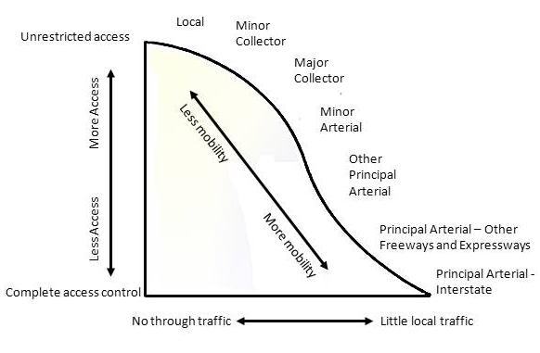
What is Functional Classification
Process by which streets and highways are grouped into classes, or systems, according to the part that any road plays in serving the flow of trips through a highway network.
A roadway’s functional usage is based on Mobility & Accessibility:
Mobility ‐ is measured in respect to ability of traffic to pass through a defined area in a reasonable amount of time.
Accessibility ‐ is measured in terms of the road system’s capability to provide access to and between land use activities within a defined area.
Notes:
Mobility: Few opportunities for entry and exit and low travel friction
Accessibility function: Provides many opportunities for entry and exit; higher travel friction

Slide 33
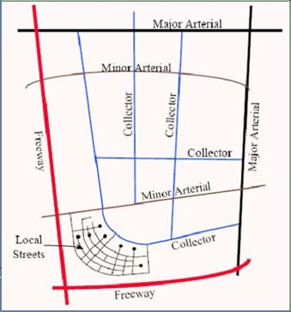
Functional Classification Criteria
Travel Speeds
Trip Distance
Interval Spacing
Population center thresholds and/or traffic generators being served
Expected Volume
Types of trips being served
Network Characteristics
Mileage extents
Notes:
For each functional classification FHWA provides criteria – examples include the following.

Slide 34
Functional Classification Decision Tree
All Roads
Arterial
Principal
Minor
(Full Access)
Non-Arterial
Collector
Local
Limited Access
Full Access
Major
Minor
Interstate
Other Freeways & Expressways
Other Principal Arterial
Notes:
Here we will present considerations for assigning and updating Functional Classification to roadways. The functional classification system groups roadways into a logical series of decisions based upon the character of travel service they provide. You should start this process starting from assigning the function of an Arterial by its level of access (limited or full) or Non-Arterial (full access).

Slide 35

How does FDOT use Functional Classification
Federal-aid highway program funding eligibility.
Highway Performance Monitoring System (HPMS) federal reporting.
Planning – Assists in long-range transportation planning by identifying areas that require improvements or construction projects.
Roadway Design – Guides the design of roadways by defining the appropriate standards for each fun class type.
Traffic Management – Assists in managing traffic flow and congestion based on fun class.
Notes:
Mobility: Few opportunities for entry and exit and low travel friction
Accessibility function: Provides many opportunities for entry and exit; higher travel friction

Slide 36
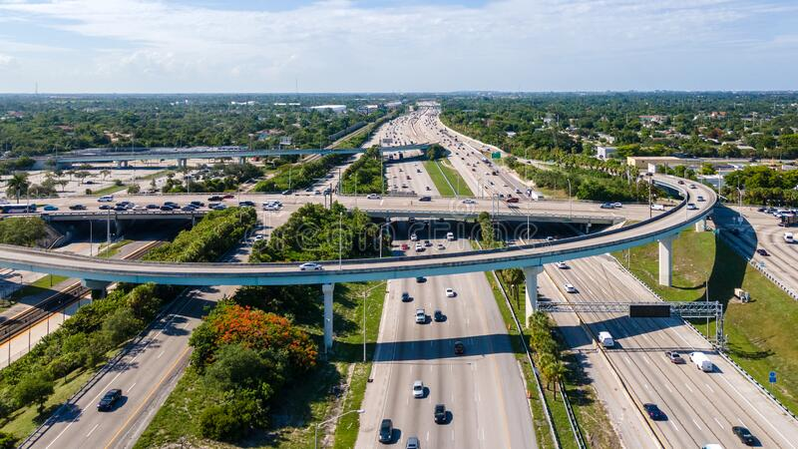

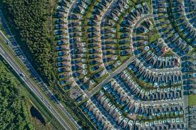
Functional Classification Influencers
Continuity
Annual Average Daily Traffic (AADT)
Connections to Activity Centers
Trip Length
Access Points
Speed Limit
Route Spacing
Number of Lanes
Notes:
There are a variety of factors that can influence the functional classification of a roadway.
Continuity – A roadway of a higher classification should not connect to a single roadway of a lower classification (there are some exceptions).
Trip Length – Longer trips indicate more principal arterial use while shorter trips indicate more local/collector use.
Access Points – In theory, surface arterials provide the least access for grade roads. Access management tries to preserve function.
Speed Limit – The higher the speed limit the higher the functional classification.
Route Spacing – Ideally, regular and logical spacing between routes of different classifications exists. Arterials are typically spaced at greater intervals than Collectors, which are spaced at much greater intervals than Locals.
Annual Average Daily Traffic – The higher the traffic volume the higher the functional classification
Number of Lanes – The higher the number of lanes the higher the functional classification
Connections to activity centers – Highly significant roadways connect large activity centers and carry longer-distance travel between and through regions.

Slide 37
Functional Classification and Trip Purpose
FHWA calls for the grouping of similarly ranked travel generators or trip purposes.
12 types of trip purpose.
Not necessary for a road to go directly to the main entrance of a traffic generator.
Principal Arterial | 2 or more of trip purposes 1-7
Minor Arterial | Only 1 of trip purpose 1-7
Major Collector | 1 or more trip purposes 8-10
Minor Collector | Trip purpose 11
Local | Trip purpose 12
Notes:
For a trip purpose identified by concept of service and consideration of proximity: It is not necessary for a road to go directly to the main entrance of a traffic generator for it to serve that traffic generator. Several connections may exist between the primary access route and the traffic generator.
We will cover all the types of trip purposes in the next slides.

Slide 38
Functional Classification: Trip Purpose 1-6
Trip Purpose 1. Travel to and through urbanized areas
Trip Purpose 2. Travel to and through small urban areas
Trip Purpose 3. National defense
Trip Purpose 4. Interstate and regional commerce
Trip Purpose 5. Access to airports, seaports, and major rail terminals or intermodal transfer facilities
Trip Purpose 6. Access to major public facilities
Notes:
Trip Purpose 1. Travel to and through urbanized areas
These are primary routes that connect one urbanized area to another. Typically, there will be only one route of Trip Purpose 1 per urban area. In selecting the primary route between two adjacent urbanized areas when more than one direct route exists, the District should first consider the route that extends to the largest number of distant urban areas. If that criterion does not provide a clear selection, the District may then consider which road serves the largest volume of traffic traveling between the two adjacent urban areas. A connected urban area may be in another state. Two routes may be considered when the amount of travel in a given corridor connecting two urban areas is substantially served by trips on more than one highway.
This is also true when an urban area is so geographically large as to result in multiple corridors having been established. This two-route option will be applied in limited cases. The TDA Office will review two-route options as proposed by the District and present them to FHWA for consideration. In general, the use of multiple highways to serve trip needs of a single corridor for this trip purpose should be recognized only when the two facilities are of different access control types (i.e., one is limited-access and the other is not). For example, Interstate 10 (I-10) is a limited access facility; US-90 that parallels I-10 is not a limited access facility.
Trip Purpose 2. Travel to and through small urban areas
These are primary routes that connect one small urban area to an adjacent small urban area, or to the network of roads connecting urban areas to each other. If there is no urban area in the county, connection should be made to the county seat.
Trip Purpose 3. National defense
A national defense route is identified as a primary National Strategic Highway Network (STRAHNET) route. National defense routes also include connector routes identified in the STRAHNET Connector Atlas. See the latest Florida Atlas.
Trip Purpose 4. Interstate and regional commerce
Routes serving this trip purpose are identified by relatively high volumes of freight movements over long distances. A U.S. route may often indicate that the designated route serves the primary purpose of interstate commerce. Those roads that serve the purpose of travel to and through urban areas are considered to serve the needs of regional commerce and thus meet both trip purposes, and vice versa. Identification of this trip purpose may involve evaluating the appropriateness of existing U.S. route designations
Trip Purpose 5. Access to airports, seaports, and major rail terminals or intermodal transfer facilities
These major routes that provide access to regional or international airports, seaports handling ocean-going or river barge traffic, and rail/truck intermodal facilities, are designated by FDOT and approved by FHWA.
Trip Purpose 6. Access to major public facilities
A route to the major point of entrance to a major public facility is considered the primary access route. Major public facilities are distinguished from minor public facilities by their frequency of use and customer service. The general guide for selecting facilities meeting this purpose is to identify those for which the generated traffic would substantially impact the performance of connecting roads, i.e., the number and frequency of trips to or from the facility would place a significant demand on the facility. For the purposes of this handbook, major public facilities are: state or private universities; community colleges; regional medical centers; natural attractions, such as beaches, rivers, and state parks, that draw from a regional area and serve an average daily attendance of 1,000 persons in a single area; manmade attractions, such as theme parks, that attract audiences from a regional area; publicly-owned cultural and historic facilities, such as performing arts centers, civic centers, and museums, that attract audiences from a regional area.

Slide 39
Functional Classification: Trip Purpose 7-12
Trip Purpose 8. Interconnection of major thoroughfares
Trip Purpose 9. Interconnection of minor thoroughfares
Trip Purpose 10. Access to concentrated property use areas
Trip Purpose 11. Access to rural diffused property use areas and lower density urban residential and commercial/industrial areas
Trip Purpose 7. Access to minor public facilities
Trip Purpose 12. Local access and circulation
Notes:
Trip Purpose 7. Access to minor public facilities
A route providing access to the major point of entrance to a minor public facility is considered the primary access route. For the purposes of this handbook, minor public facilities are those not meeting the requirements listed in Trip Purpose 6, access to major public facilities, and include manmade attractions and publicly owned cultural and historical facilities that attract local audiences.
Trip Purpose 8. Interconnection of major thoroughfares
A route that provides a high-volume cross-connection between roads that meet at least two of the trip purposes, 1 through 6, qualifies for this trip purpose. The intent is to ensure that the trips being observed are for through traffic seeking to reach the distant major road.
Trip Purpose 9. Interconnection of minor thoroughfares
A route that provides cross-connection between roads that meet at least one of the trip purposes 1 through 7 qualifies for this trip purpose.
Trip Purpose 10. Access to concentrated property use areas
This is a route that connects major thoroughfares to concentrations of property use, such as the primary connection to a community, large residential subdivision, neighborhood shopping center, or a public facility serving a local audience.
Trip Purpose 11. Access to rural diffused property use areas and lower density urban residential and commercial/industrial areas
A route that connects major thoroughfares to diffused areas of a single or mixed property use and lower density urban residential and commercial/industrial areas serves this trip purpose. Such areas include the primary connection to a rural farming area consisting of large acreage tracts, and scattered small residential developments or in urban areas, lower density residential and commercial/industrial areas.

Slide 40
Functional Classification Update Triggers
New significant roadways that may warrant Arterial or Collector status
Any Principal Arterial roadway reconstructed as a divided facility
Construction of major development that has caused traffic patterns to change
Significant growth that causes new access or mobility needs
Arterial or Collector roadways been extended or to attract more through trip movements?
Significant growth in daily traffic volumes?
Functional Classification can change over time.
Most roadways functional classification remains stable.
When updating functional classification, the focus should be to identify where a road’s function has changed.
Notes:
While the functional classification of roadways can and do change over time, the functional classification of most roadways remains stable. When updating functional classification, the focus should be to identify where a roadway’s functionality has changed.

Slide 41
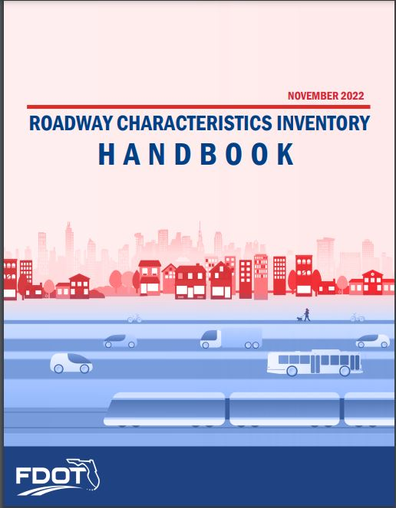
Functional Classification – Data Inventory Requirements
If a road is newly categorized under one of the functional classification categories and was not previously included in the RCI LRS, it should be inventoried according to the guidelines provided in the RCI handbook.
Be mindful of District resources when inventorying new roadways.
Notes:
Roadways functionally classified as minor collectors and above which are also considered Active off the SHS are required to be included in the RCI, LRS, and part of the District’s five-year off-system inventory cycle. These roadways are collected in RCI as part of the adjusted Urban Boundary and Functional Classification update process following every Census for FHWA HPMS reporting purposes. Refer to the Active Off the SHS RCI inventory matrix in the Appendix A of this handbook for the required features and characteristics for all roadways functionally classified as rural minor collector and above.

Slide 42

Urban Area Boundary:
Dos and Don’ts

Slide 43
Urban Area Boundary – Do’s and Don’ts
Do’s | Don’ts
At a minimum, confirm Census boundaries are adequate Urban and rural demarcation defined by function, not urban area boundary Roads that define a boundary should be consistently urban or rural At a minimum, areas must encompass entire U.S. Census Bureau urban area Include entire municipality Boundaries should not split roadways or ramps. | Shrink U.S. Census Bureau urban areas. Ignore coordination of multi-state urban areas. Ignore coordination of multi-district urban areas.
Notes:
Roadways functionally classified as minor collectors and above which are also considered Active off the SHS are required to be included in the RCI, LRS, and part of the District’s five-year off-system inventory cycle. These roadways are collected in RCI as part of the adjusted Urban Boundary and Functional Classification update process following every Census for FHWA HPMS reporting purposes. Refer to the Active Off the SHS RCI inventory matrix in the Appendix A of this handbook for the required features and characteristics for all roadways functionally classified as rural minor collector and above.

Slide 44
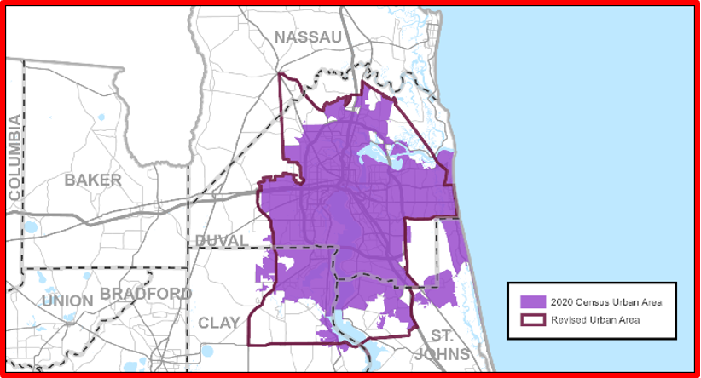
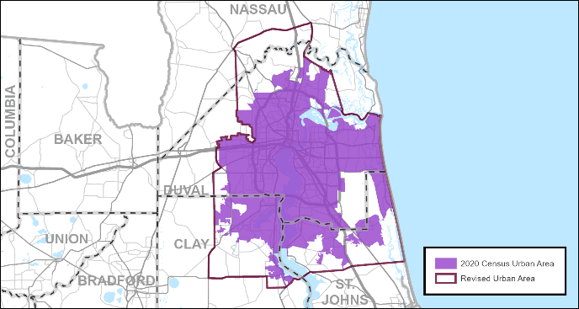
Common UA Adjustment Errors
Adjusted UA missing portion of Census boundary
Adjusted UAs should encompass entire Census area at a minimum
Notes:
Make sure that the entire original Census urban area is contained within the adjusted urban area boundary.
This is demonstrated with the two examples on the screen.
The purple area represents the Census boundary and the blue outline represents the Urban Area boundary.
The example on the left shows the Census boundary left out of the Urban Area and the right shows a corrected boundary.
At a minimum, Adjusted Urban Areas should contain the entire Census boundary.

Slide 45
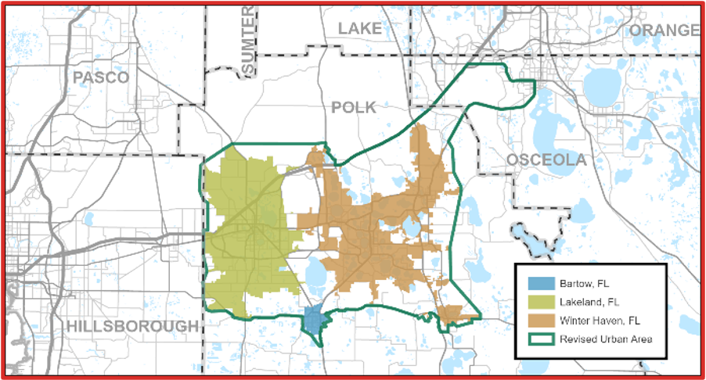
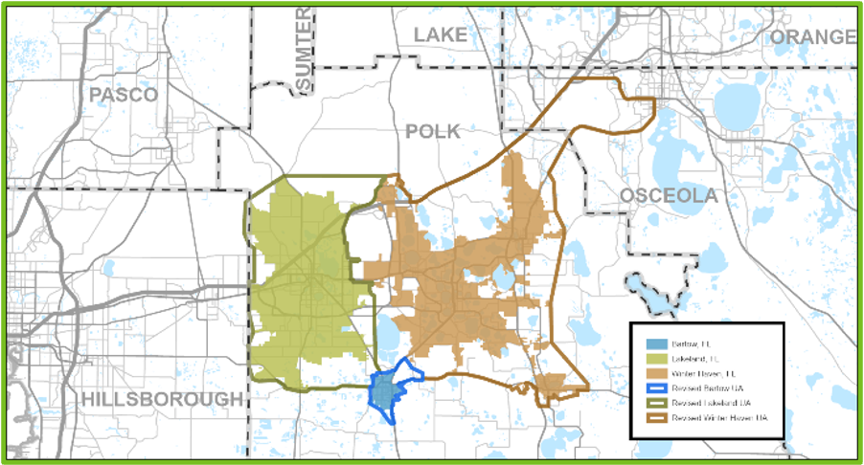
Common UA Adjustment Errors
Multiple Census UAs should not be combined to one adjusted UA
One-to-One Relationship
Notes:
Multiple Census urban areas should not be combined into one adjusted urban area boundary. Each urban area should have its own urban area boundary.
The map on the left is an example of this where three Census boundaries are contained in one single Urban Area boundary.
The map on the right provides a correct example where each of the three Census boundaries are their own Urban Area boundary.

Slide 46
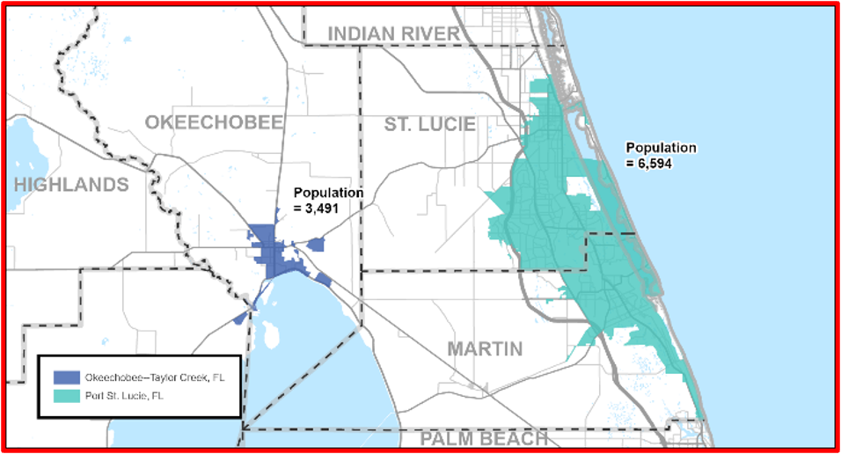
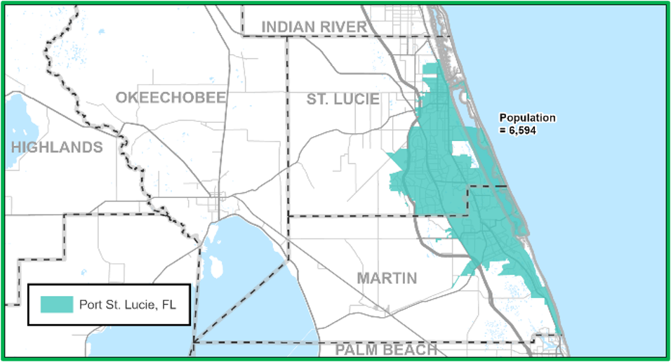
Common UA Adjustment Errors
FHWA UAs have population of at least 5,000
Population too small
Notes:
Only Census Urban areas with population greater than or equal to 5,000 are considered FHWA Urban Area Boundaries. Do not adjust any urban areas with population less than 5,000.
The example on the left includes an Urban Area with a population of 3,491 which is too small to be defined as such.
The example on the right reflects the correct Urban Area with a population of 6,594.
According to the Federal Highway Administration, Urban Area boundaries must have a population of at least 5,000.

Slide 47
Functional Classification:
Dos and Don’ts
Notes:
Let us delve now into FC guidelines and considerations.

Slide 48
Functional Classification – Do’s and Don’ts
Do’s | Don’ts
Common sense should be your guide. Look at overall distribution and spacing when in doubt. Be consistent with community standards. Include Annual Average Daily Traffic (AADT) when submitting functional classification applications. Coordinate with other States/Districts/Counties to ensure functional classification at State/District/County lines are consistent. RCI Features 121 and 124 must be updated whenever changes occur, and they must complement each other; Feature 121 directly affects Feature 112 (federal systems); Districts should request TDA to update Feature 112. | If the difference in length between the digitized and RCI alignments is greater than or equal 0.100 miles or 5% of the RCI length, Districts should provide marked-up aerials displaying the correct alignment for comparison with the RCI LRS. If a realignment of a roadway has not been digitized into the RCI LRS, the correct realignment should be shown on a copy of the latest aerial image. Districts should make sure the location of the realignment can be determined within the county by adding discerning features. RCI feature 140 (section status exception) must be coded correctly, and the total realignment length must be correctly noted in RCI. Feature 138 (roadway realignment) must be completed. Problems will occur if two or more section numbers are assigned to the same section of roadway or to overlapping roadways. If this is determined to be an exception, code it in properly. If not, the problem will need to be corrected by field or map review.

Slide 49

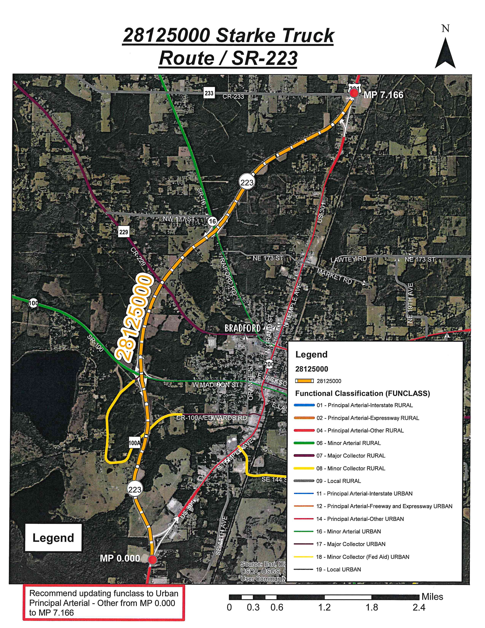
Major Construction/Expansion
Roadway Name: Starke Truck Bypass Route/SR-223/US-301A
District: 2
Corridor Length: 7.166 mile
Number of Lanes: 4
AADT: 25,000 (2020)
Proposed FC: Urban Principal Arterial – Other
Earlier FC: Urban Local
Justification: Truck route, congestion relief on US-301, additional capacity for future traffic growth
Notes:
The section was created as a truck route to relieve congestion on US-301 in Starke. The proposed roadway is expected to provide additional capacity for future traffic growth.

Slide 50
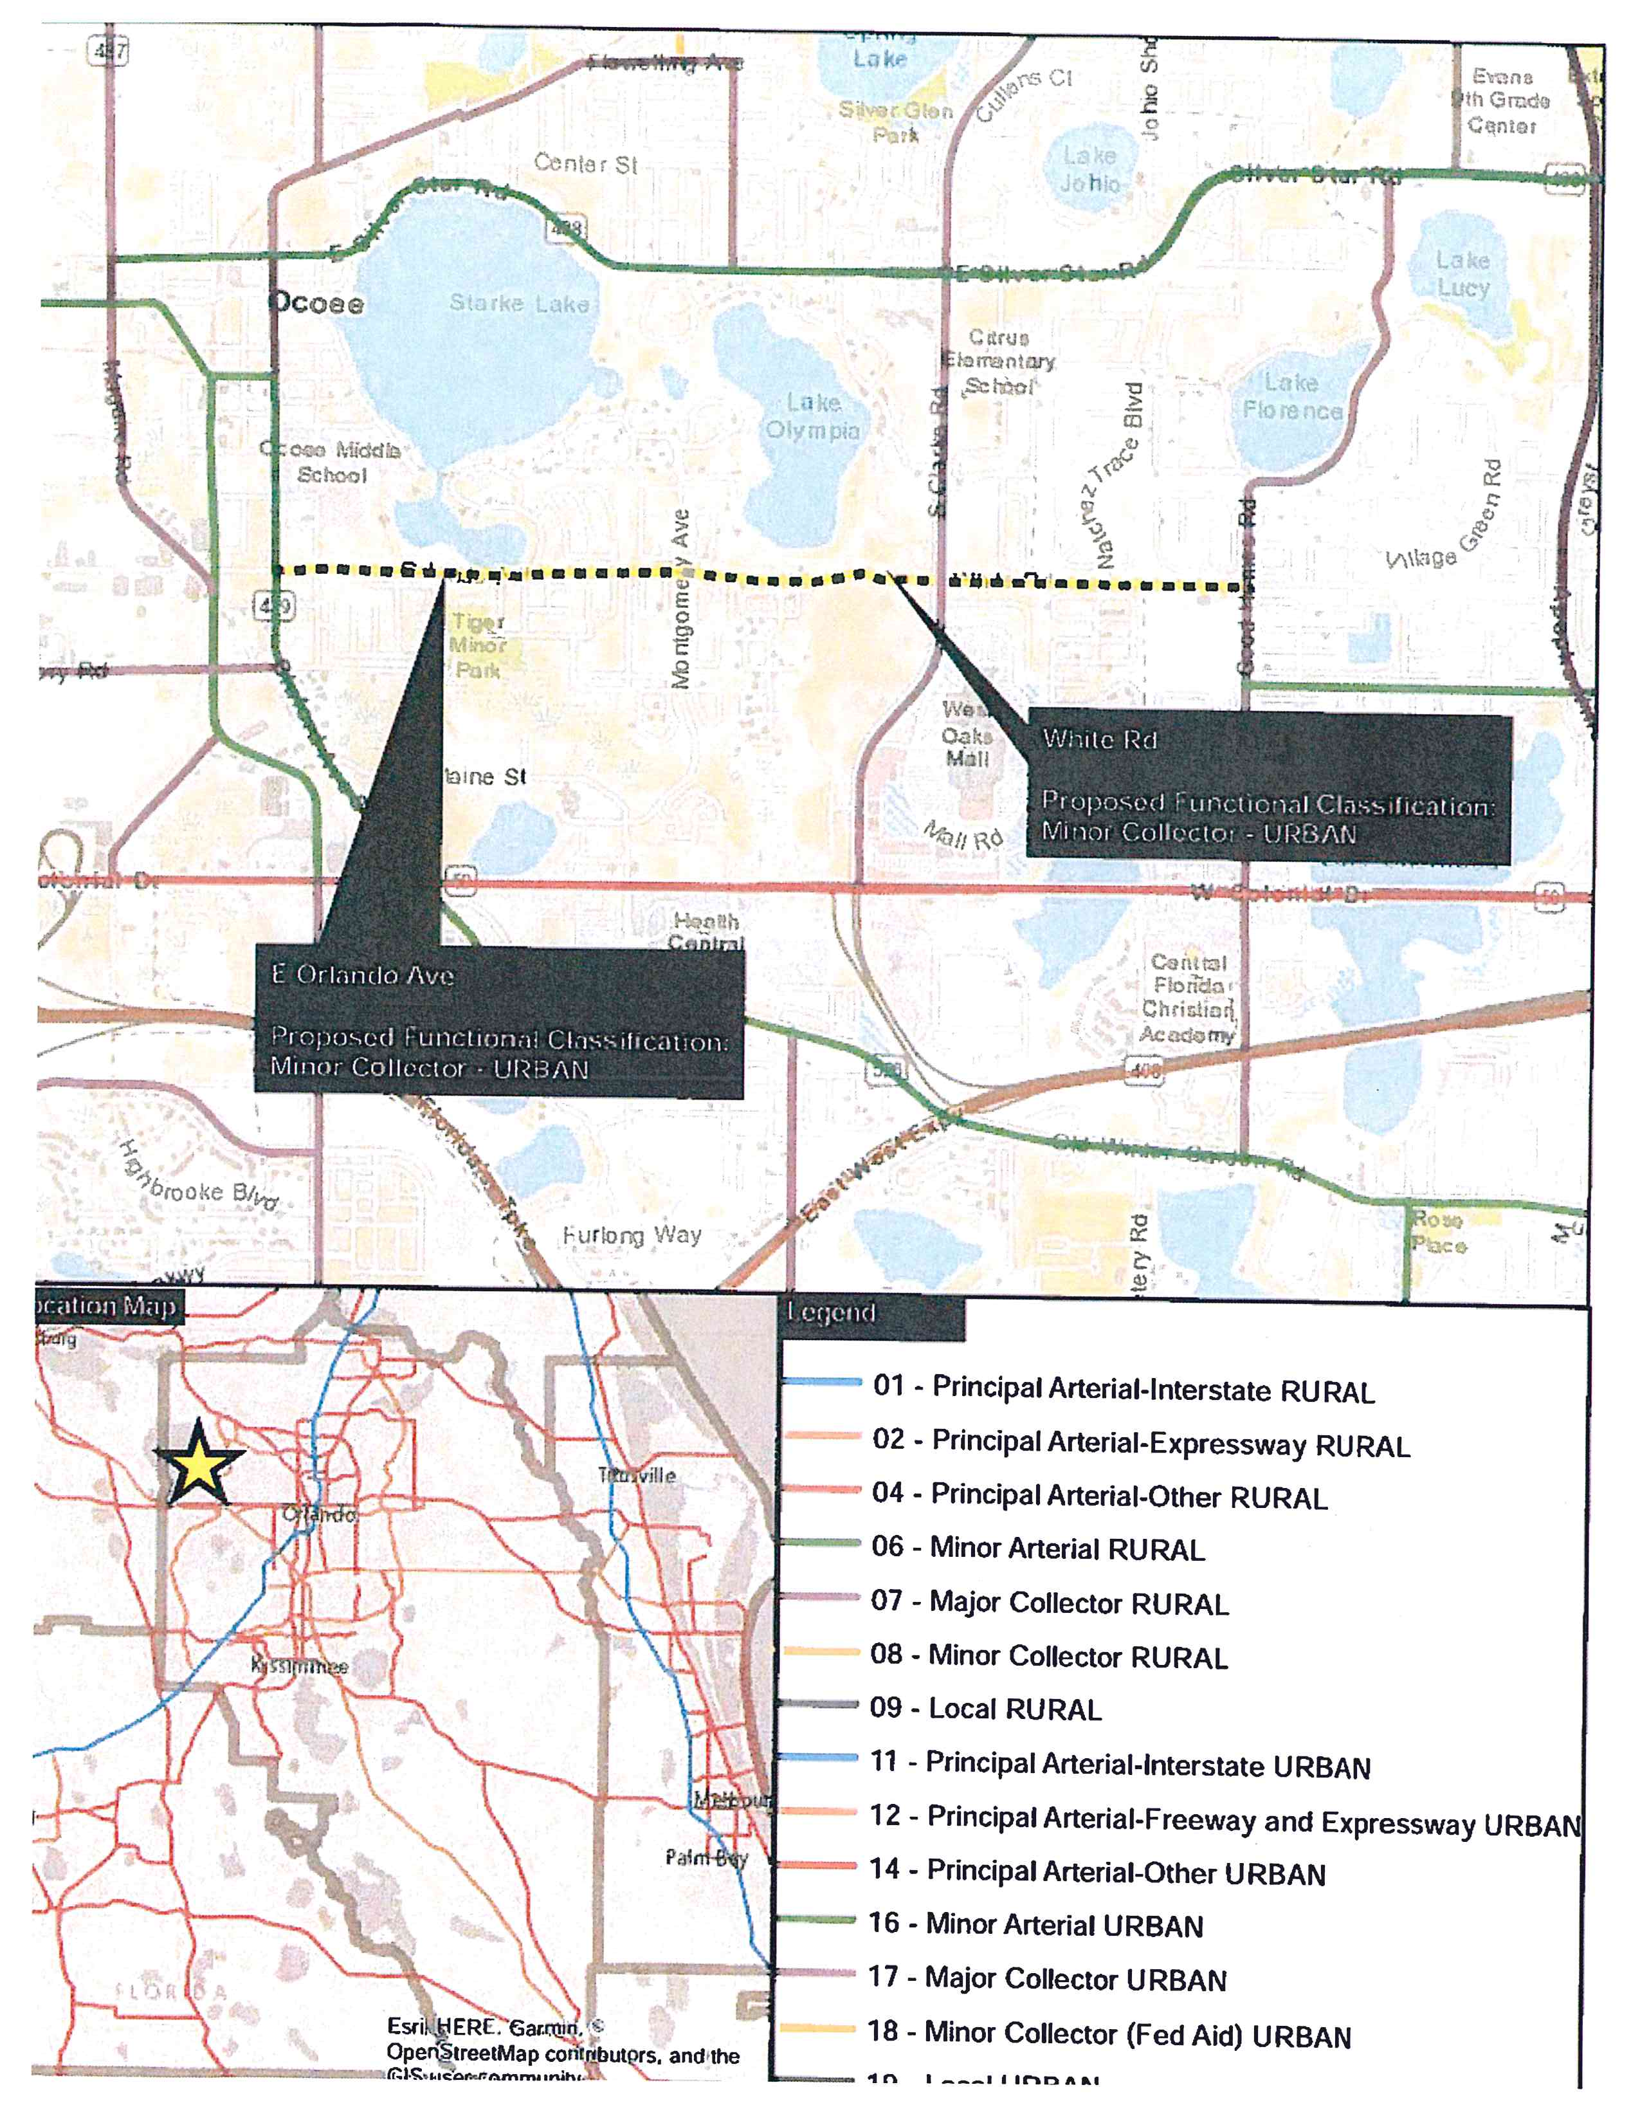
Infrastructure Improvements
Roadway Name: E Orlando Ave/White Road
District: 5
Corridor Length: 2.377 mile
Number of Lanes: 2
AADT: 8,698 (2017)
Proposed FC: Urban Minor Collector
Earlier FC: Urban Local
Justification: Meets Trip Purpose 9, 11. Secondary access to school, Parallel relief road for SR 438 and SR 50.
Notes:
Urban Local to Urban Minor Collector 75000130 2018 - E Orlando Ave and White Road connect S Bluford Ave/SR-439 (Urban Minor Arterial) to Good Homes Road (Urban Major Collector) and meets trip purpose 9 (interconnection of minor thoroughfares). This corridor meets trip purpose 11 (access to lower density urban residential and commercial/industrial areas). Additionally, this corridor provides secondary access to West Oaks Mall and Ocoee Elementary School. The corridor is a parallel relief road for SR-438 (Urban Minor Arterial) and SR-50 (Urban Principal Arterial).

Slide 51
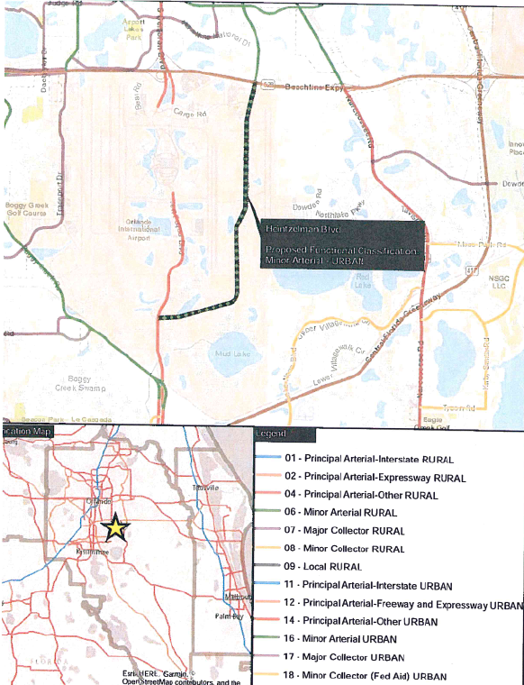
Multimodal Purpose
Roadway Name: Heintzelman Blvd
District: 5
Corridor Length: 4.659 mile
Number of Lanes: 2
AADT: 8,572 (2017)
Proposed FC: Urban Minor Arterial
Earlier FC: Urban Local
Justification: Meets Trip Purpose 8. Provides direct access to Orlando International Airport.
Notes:
Urban Local to Urban Minor Arterial 75000150 2018 - This roadway provides direct access to the Orlando International Airport and meets trip purpose 8 (interconnection of a major thoroughfare).

Slide 52
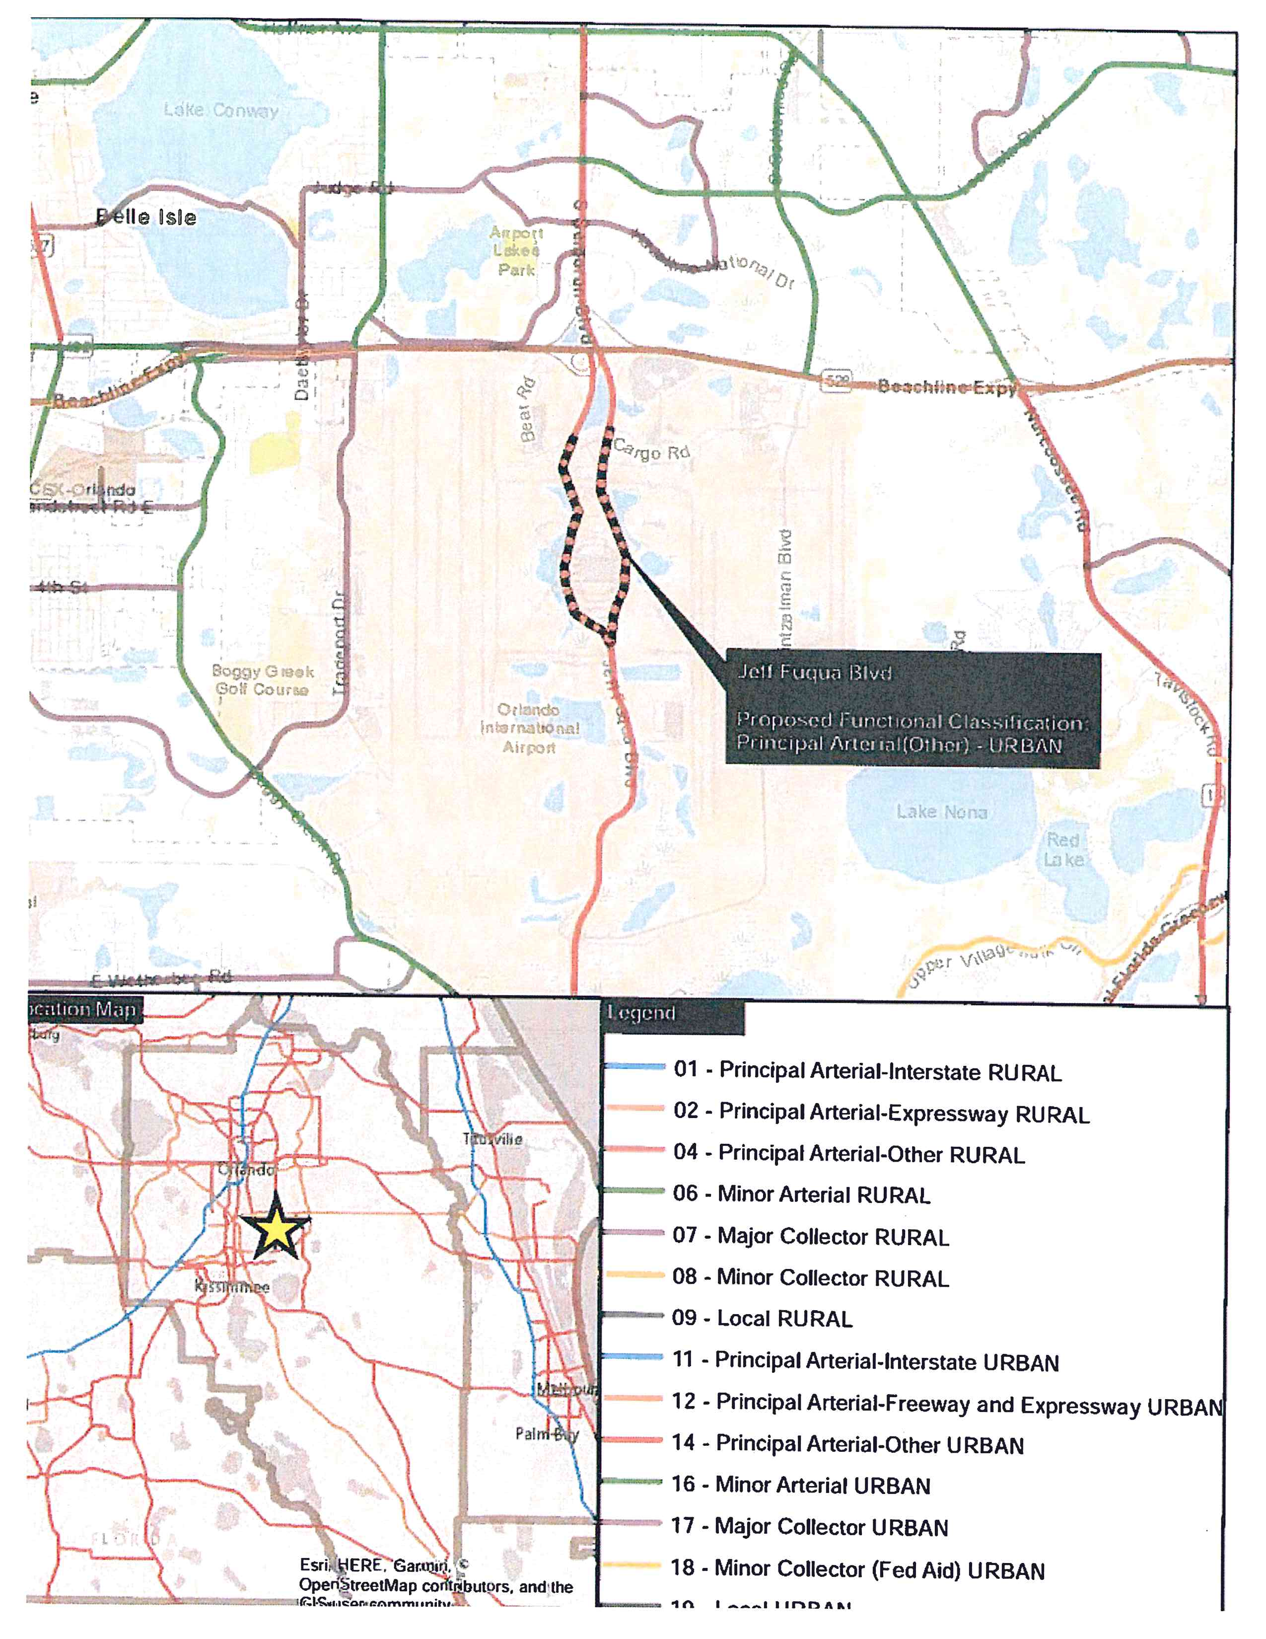
Extension of Prior Section
Roadway Name: Jeff Fuqua Blvd
District: 5
Corridor Length: 1.471 mile
Number of Lanes: 6
AADT: 36,561 (2017)
Proposed FC: Urban Principal Arterial - Other
Earlier FC: Urban Local
Justification: Meets Trip Purpose 5, 8. Extension of SR 436 from north connecting to Jeff Fuqua Blvd in south
Notes:
Urban Local to Urban Principal Arterial 75000301 2018 - Extension of Semoran Blvd. Meets trip purpose 5 (access to airports, seaports, and major rail terminals or intermodal facilities) and trip purpose 8 (interconnection of major thoroughfares).

Slide 53
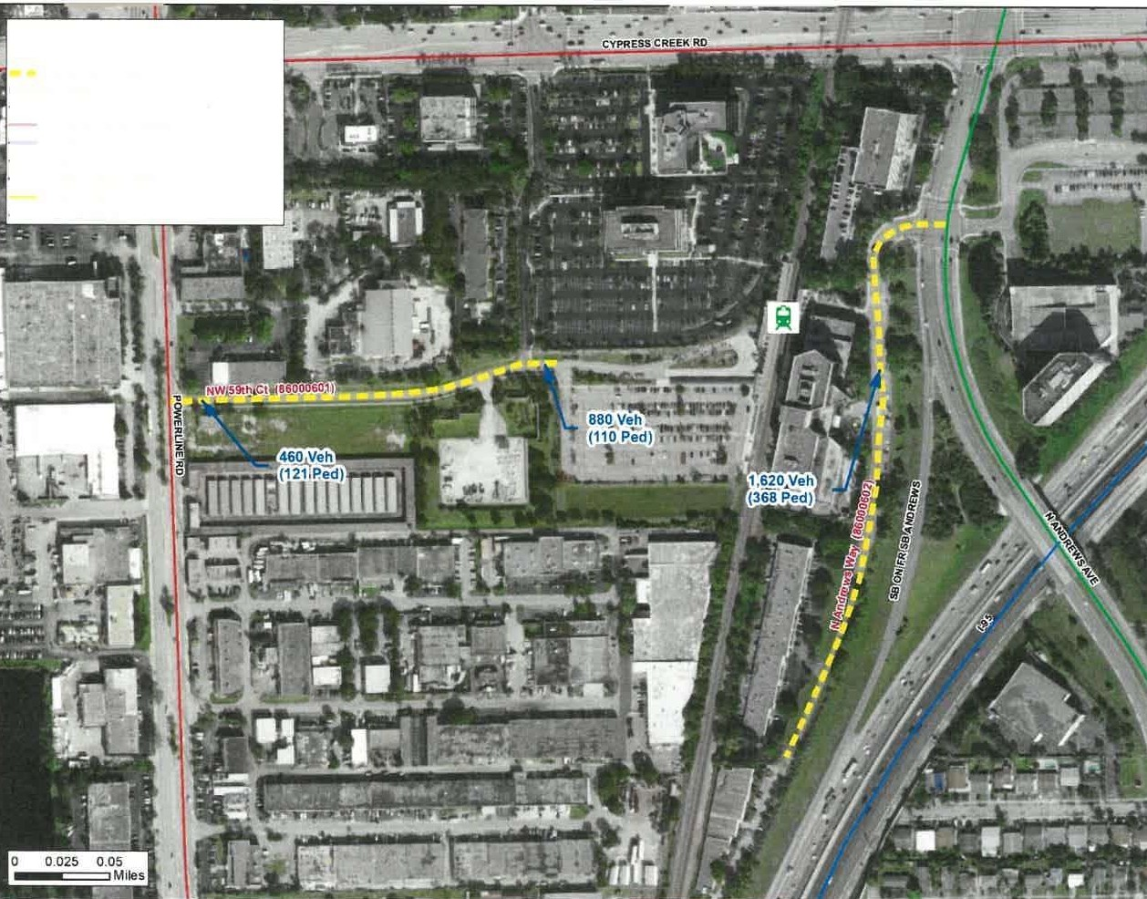
Land Use
Roadway Name: NW 59 CT
District: 4
Corridor Length: 0.21 mile
Number of Lanes: 2
AADT: 460 (2018)
Proposed FC: Urban Minor Collector
Earlier FC: Urban Local
Justification: Multimodal connection for pedestrian to Tri-Rail station, meets criteria: less than 3/4th of a mile, connected to a large trip generator.
Notes:
Urban Local to Urban Minor Collector 86000601 2019 - Provides a multimodal connection, especially for pedestrians, to access an Urban Fixed Guideway Terminal on Florida's Strategic Intermodal System (SIS), i.e., the Cypress Creek Station of Tri-Rail, for interregional travel. Meets the following criteria recommended in FHWA's FunClass procedures guide: (1) less than three-quarters of a mile, and (2) connected to a large trip generator.

Slide 54
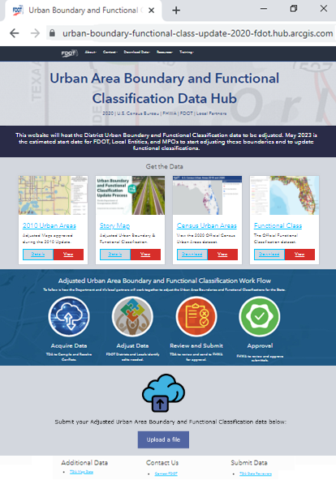
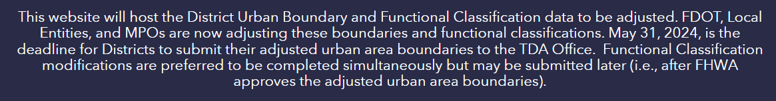
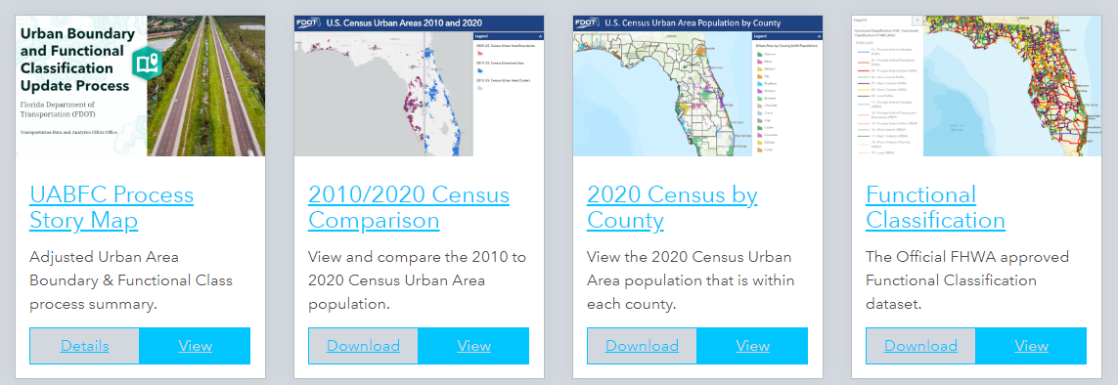

2020 Urban Area Boundary and Functional Classification Hub Site
Hub site hosts the 2020 Urban Area Boundary and Functional Classification (UABFC) data to be adjusted.
Viewable by the public.
2010 Urban Areas, Urban Clusters, Urbanized Areas are provided as reference.
Adjusted data to be submitted through Hub site.
Provides guidance from FDOT, U.S. Census Bureau, and the Federal Highway Administration (FHWA).

Slide 55
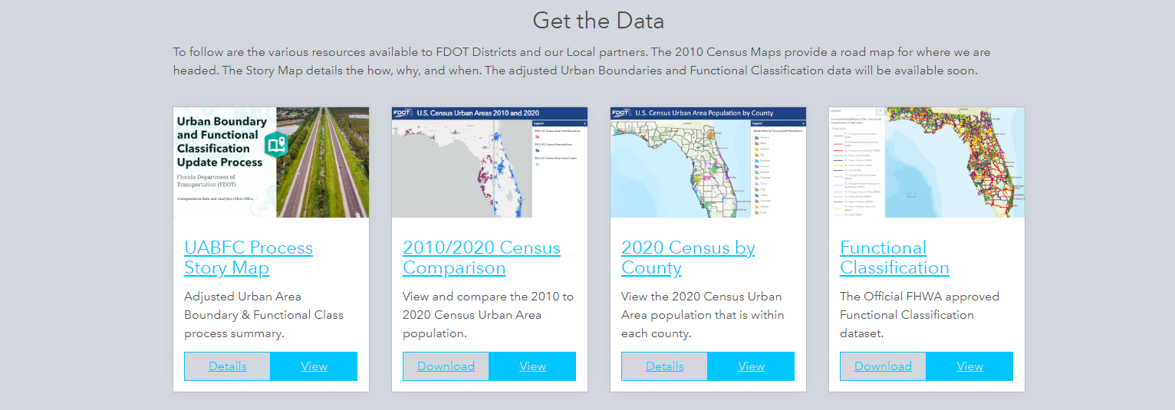
Available Data on the UABFC Hub Site

Slide 56
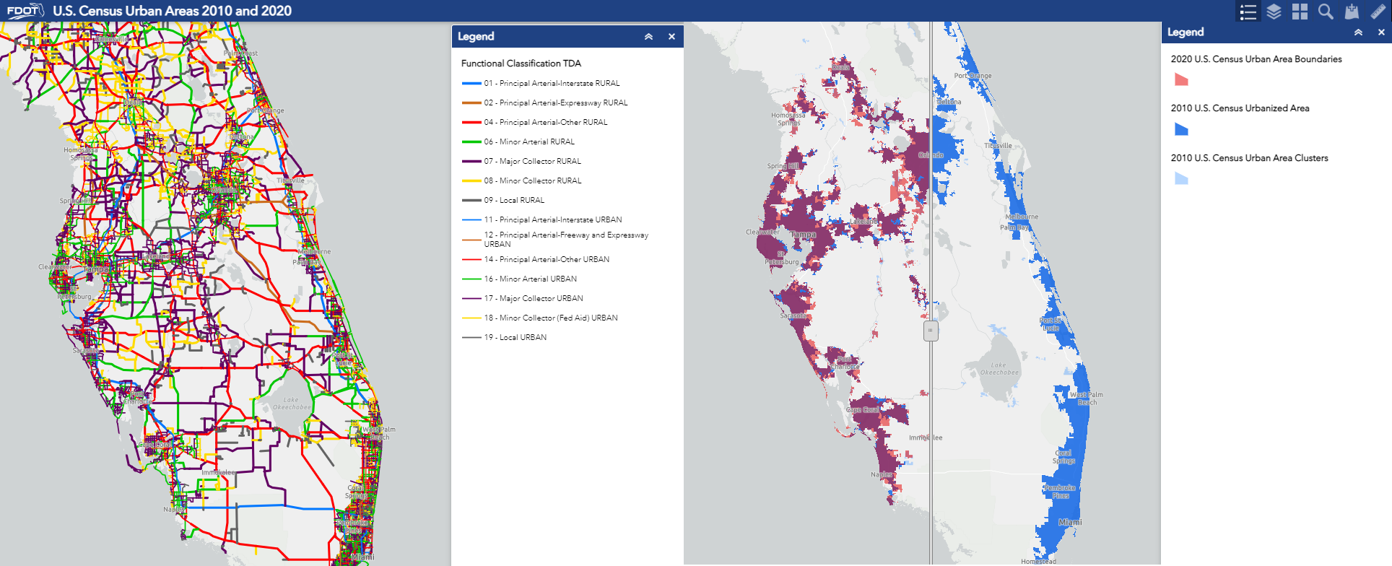
2010/2020 UABFC Comparison Tool

Slide 57
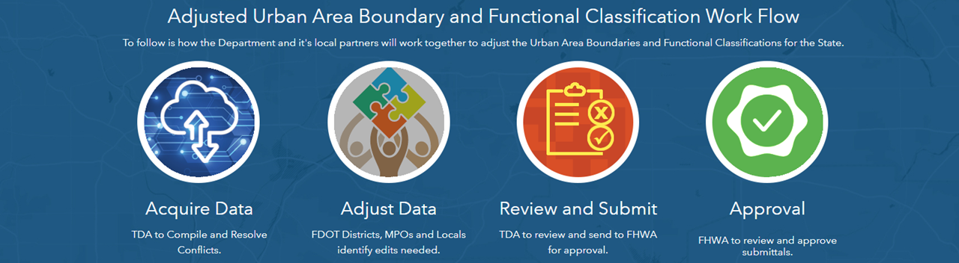

UABFC Adjustment Workflow and Data Submission

Slide 58
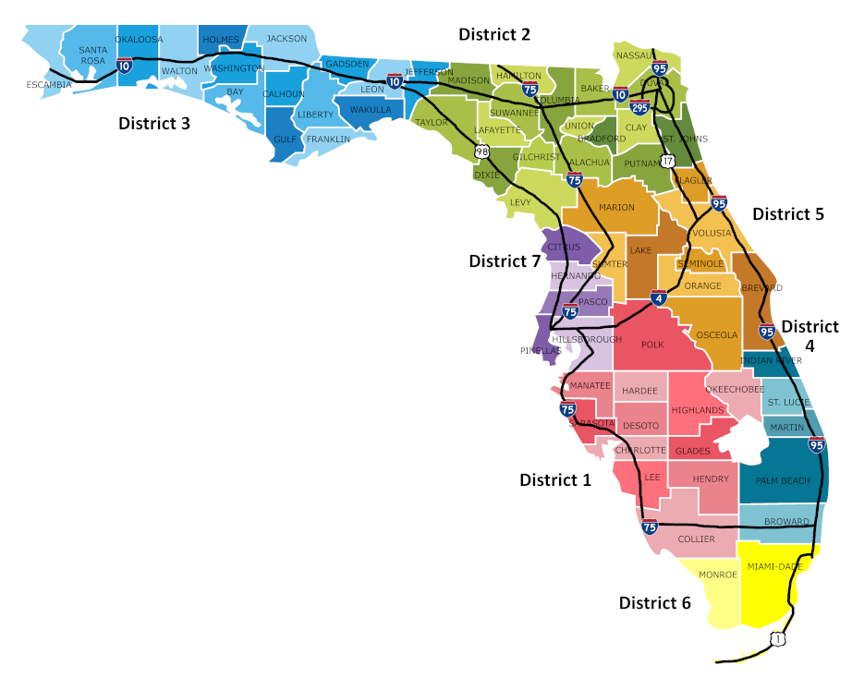

UABFC Adjustment Workflow and Data Submission
Data to be submitted by these users only:
District 1 – Kyle Purvis, Joel Graeff.
District 2 – David Tyler, Justin Bellot, Brian Austin.
District 3 – Geoff Hynes, Mark Brock, Bryant Paulk, Corey Webb, Cindy Boyette.
District 4 – Kara Schwartz-DiMaina.
District 5 – Alice Giuliani, Cheryl Burke, Jim Wood, Clif Tate, Jason Learned.
District 6 – Ana Calleja, Ken Jeffries.
District 7 – Sherry Melaragno, Anita Montjoy, Brian Hunter, Andrew Tyrell.
Turnpike – Juan Echevarria.

Slide 59
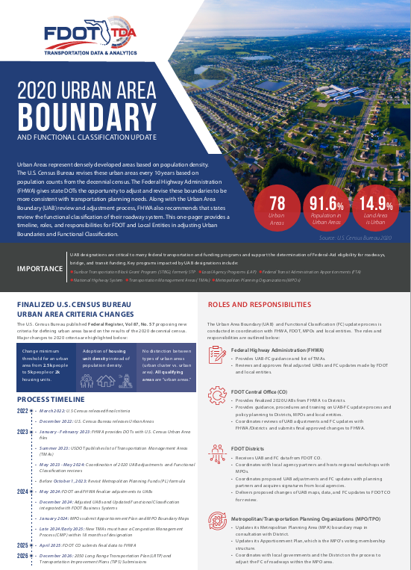
Resources
2020 UABFC Process Web Site
FDOT UABFC Hub Site
FDOT 2010 Urban Boundary and Functional Classification Maps
FDOT Urban Boundary and Functional Classification Handbook
FDOT 2020 UABFC Info Fact Sheet (PDF)
FHWA 2013 Edition - Highway Functional Classification Concepts, Criteria and Procedures
FHWA 2020 Estimated Schedule of Activities
FHWA Frequently Asked Questions
US Census 2020 Final Urban Area Criteria
2020 Urban Area Boundary and Functional Classification Fact Sheet

Slide 60
Questions?
For Data Questions:
Transportation Data and Analytics Office
Joel Worrell
Transportation Data Inventory Manager
605 Suwannee Street
Tallahassee, FL 32399
Phone: (850) 414-4715
Email: Joel.Worrell@dot.state.fl.us
https://www.fdot.gov/statistics/
Jerry Scott
Multimodal Data System Coordinator
Phone: (850) 414-4714
Email: Jerry.Scott@dot.state.fl.us
For Apportionment Questions:
Office of Policy Planning
Mike Neidhart, PhD, AICP
Metropolitan Planning Administrator
605 Suwannee Street
Tallahassee, FL 32399
Phone: (850) 414-4905
Email: Mike.Neidhart@dot.state.fl.us

